Slide 1
Pattern Recognition
Project 1
Lukas Drexler, Leif Van Holland, Reza xxxxx, Mark Springer, Maximilian Thiessen

Slide 2

1. Task

Slide 3
2. Task

Slide 4
3. Task

Slide 5
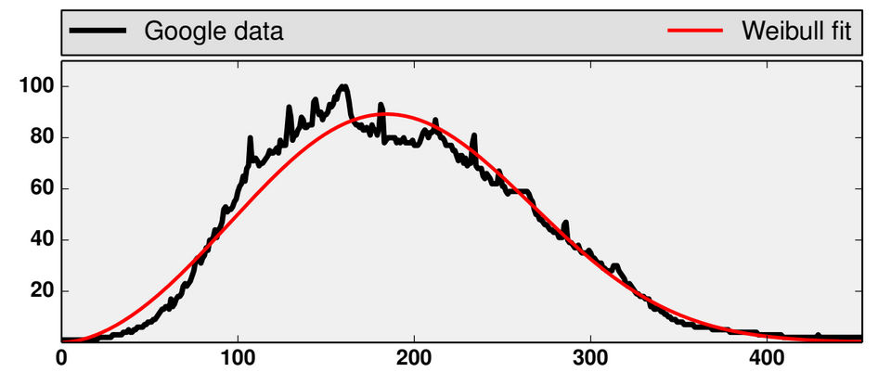
3. Task
Fit weibull distribution
to given data
Estimate parameters
and by
maximum likelihood

Slide 6
3. Task – Using histogram
Use only the histogram data and not the whole
Small example:
is the absolute frequency
is the set of all possible values

Slide 7
3. Task – Using histogram
Sum over D:
Sum over function of D:

Slide 8
3. Task – Newton Method
Applied the method
from the task description
Tried more steps

Slide 9
Task 3 – ODE Method

Slide 10
Task 4

Slide 11
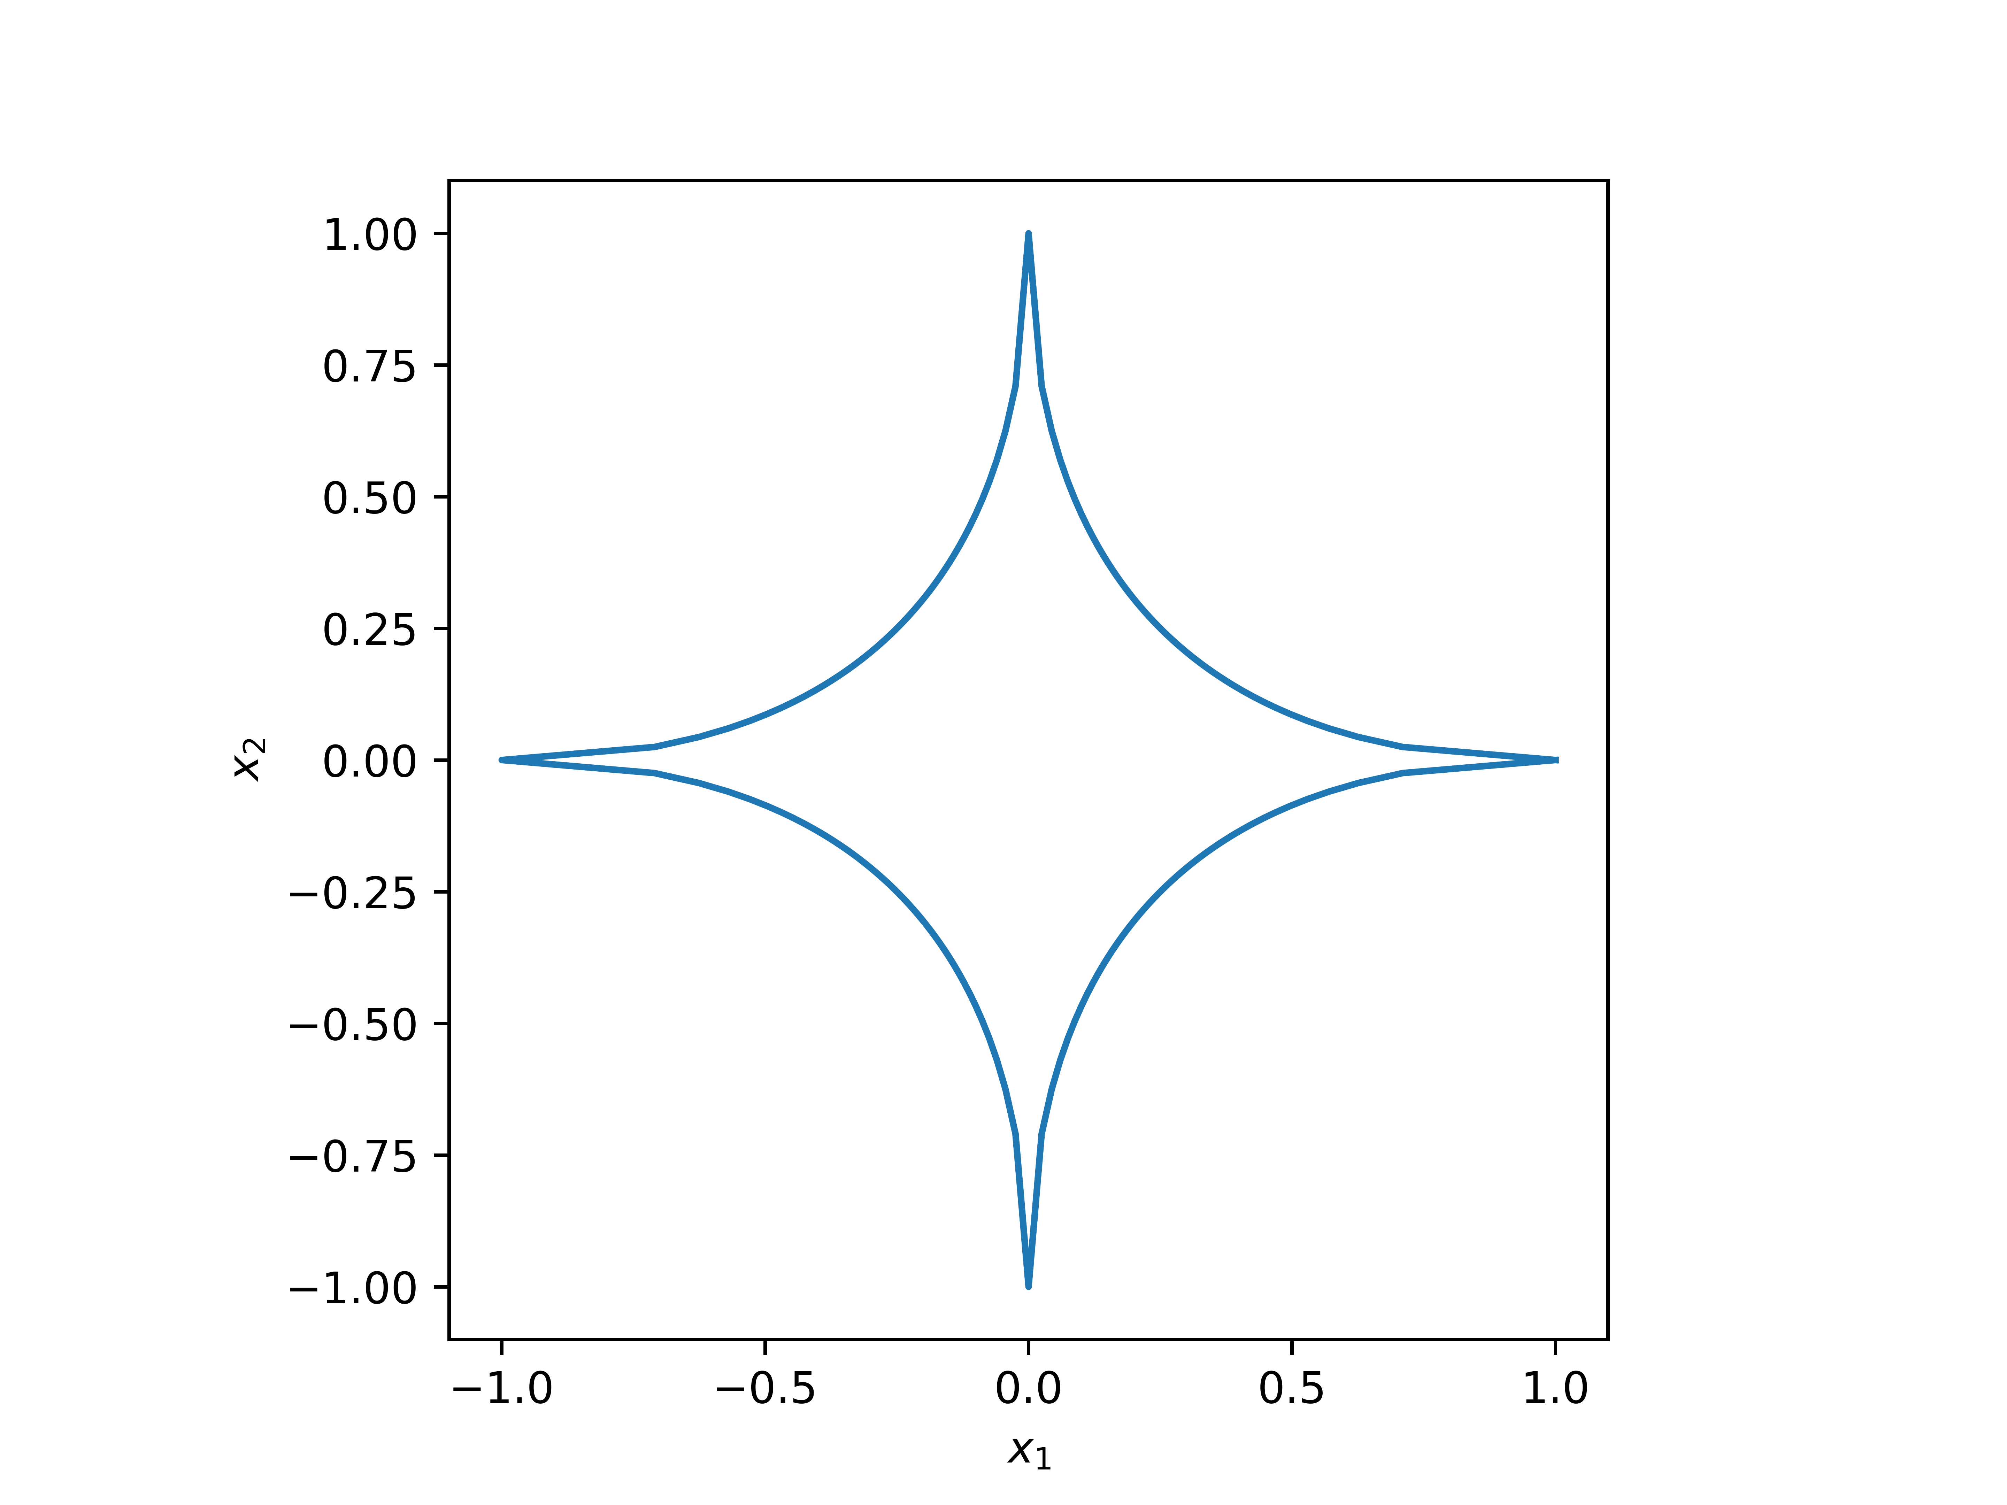
Task 4 – (not) a norm
Consider
defined like a p-norm for

Slide 12
Task 4 – (not) a norm
for it to be a norm, following axioms have to hold:
(definiteness)
(abs. homogeneity)
(triangle inequality)

Slide 13
Task 4 – (not) a norm
for it to be a norm, following axioms have to hold:
(definiteness)
(abs. homogeneity)
(triangle inequality)

Slide 14
Task 4 – (not) a norm
(triangle inequality)
consider unit vectors

Slide 15
Task 4 – (not) a norm
(triangle inequality)
consider unit vectors

Slide 16
Task 5

Slide 17
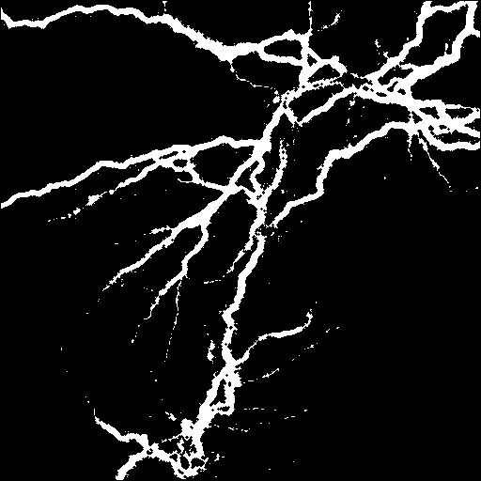
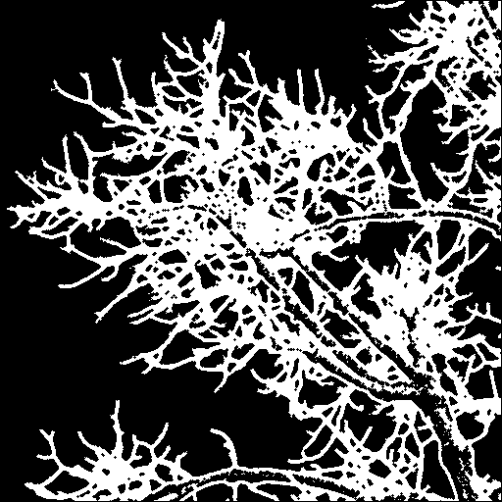
Task 5 – Box counting dimension
calculate box counting dimension
3 steps
  binarize image
  count boxes containing white pixels
  linear regression

Slide 18
Task 5 – Box counting
split matrix into four equally sized submatrices
count number of submatrices containing at least one white pixel
recursively split those submatrices

Slide 19
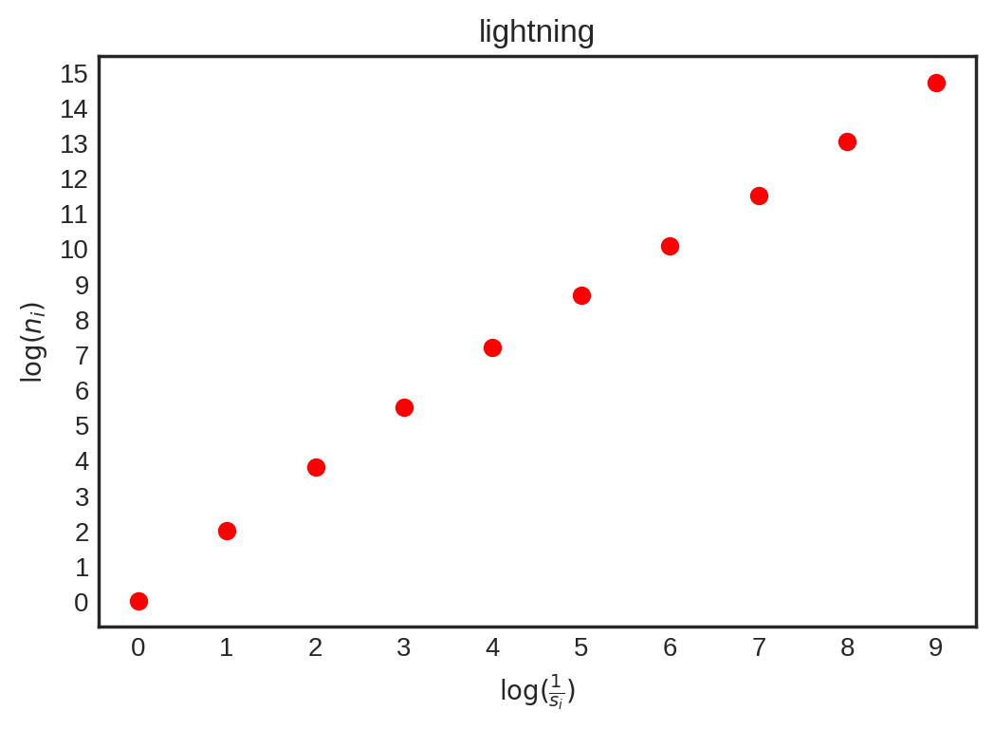
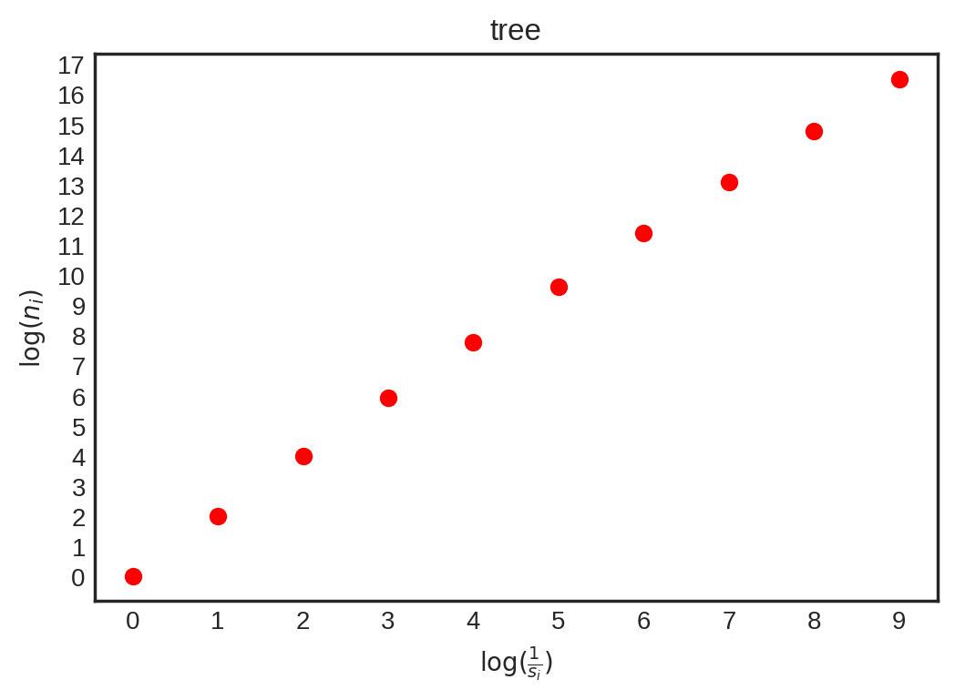
Task 5 – Box counting

Slide 20
Task 5 – Linear regression
regression by least-squares
  find a,b, such that
  is minimized
matrix-vector formulation (as shown in lecture)

Slide 21
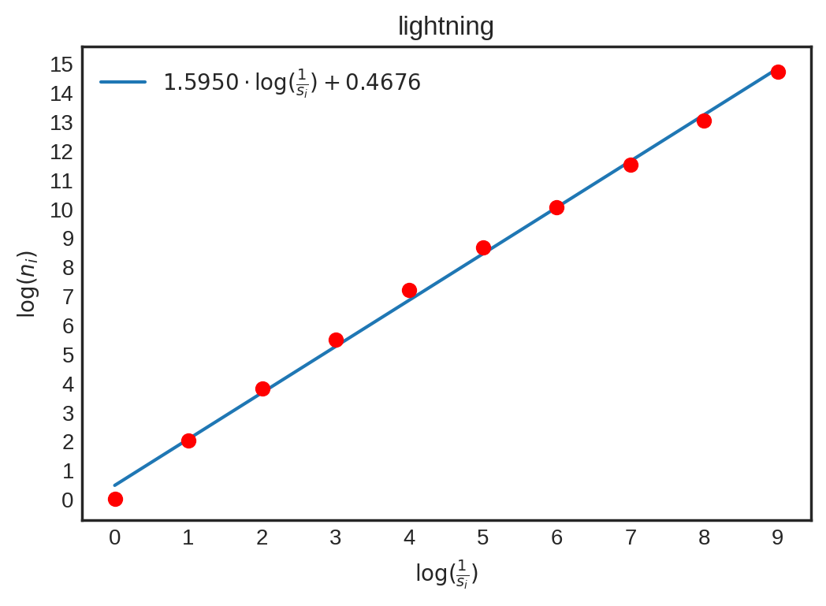
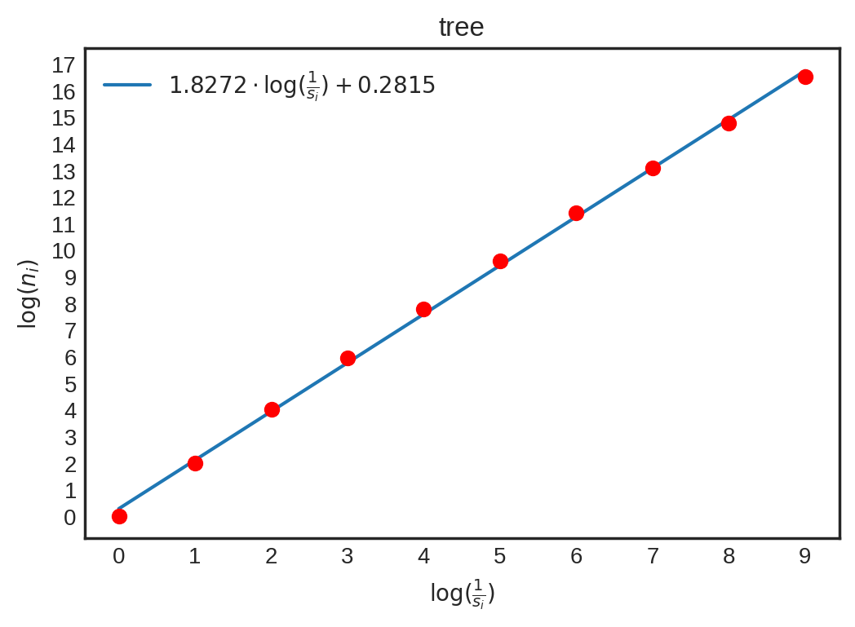
Task 5 – Linear regression
dimension slope
  lightning: D = 1.595
  tree: D = 1.8272

Slide 22
Thank you for your attention!

